Slide 1
Interview Prep Report
PROJECT 3 · FINAL PRESENTATION
A job ad and a CV go in. A one-page interview brief, with sources, comes out.
Roodabeh Seif · Career services · Built with n8n
Notes:
About 20 seconds. “I’m Roodabeh. I built an agent that prepares job seekers for an interview. You give it a job ad and your CV, and in about a minute you get a one-page brief: what to say about the company, which of your examples match the role, what to prepare, and which questions to expect.”

Slide 2
Good candidates still walk in unprepared
WHY · THE PROBLEM
WHO
WHAT THEY DO TODAY
THE PAIN
Job seekers
Research by hand
Hours
A professional with an interview next week, often applying to several roles at once.
per interview, and the preparation is still generic instead of tailored to this role.
Read the company site and news, reread the job ad, and pick their own examples.
Project 3 · Roodabeh Seif
Notes:
About 40 seconds. If you have your own number from your job search, say it, for example: in my own job search, this took me about X hours per interview. “The person is a job seeker with an interview coming up. Today they research the company, reread the job ad, and try to match their experience by hand. That takes hours for every single interview, and most people still prepare generically, not for this specific role.”

Slide 3

Five steps, no human in between
HOW · THE DATA FLOW
1
2
3
4
5
Trigger
Collect
Check
Write
Deliver
A web form: company, job ad, CV, GitHub
Job page, company research, news, similar employers, projects
Every claim must trace to the CV or a source
AI writes an eight-part brief
A formatted report, ready to save as PDF
Every error says what happened and what to do next: fix your input, paste the job text, or try again later.
Project 3 · Roodabeh Seif
Notes:
About 40 seconds. “The user fills in one form. The agent reads the job ad, even from a link, collects the candidate’s CV and public projects, and researches the company and recent news. The key step is Check: every statement must be traced back to the CV, a real project, or a search result, or it’s removed. Then the AI writes the brief and the user sees it right in the form. And if something goes wrong, the user is never left guessing. Every error says whether it is their input, for example a job link we can’t read, so please paste the text, or a problem on our side, so please try again later. And there is always a button back to the form.”

Slide 4
See it work
HOW · LIVE DEMO
“Packmatic” + a Product Designer job ad + a fictional CV → a one-page brief
1
2
3
4
Start it
Watch it run
Open the report
Prove it
Fill in the form with a real job ad
Data moves through each step
The finished brief appears
Click a source link
Project 3 · Roodabeh Seif · Backup recording ready
Notes:
At least 2 minutes. Submit the form before you start presenting, because a run takes about 4 minutes. Switch to n8n. 1) Show the form: company “Packmatic” (spelled exactly), the pasted job text, and test_cv_maya_keller.md. 2) Show the finished run on the canvas: all steps green, point at Check. 3) Show the formatted report: matches with CV quotes, skill gaps, questions, similar employers, then the Save as PDF button. 4) Click one source link. If time: show the error path by submitting without a CV. If Wi-Fi or an API fails, show the saved Packmatic PDF or the backup recording.

Slide 5
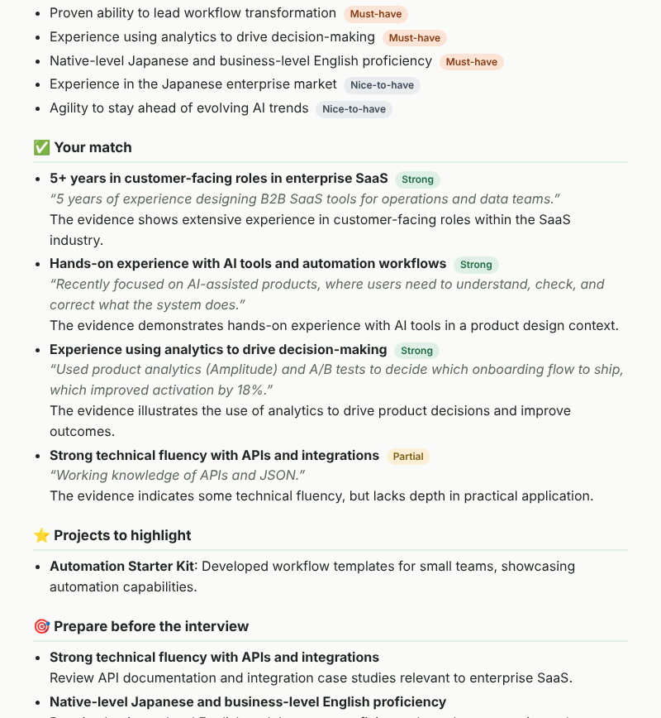
What the user gets
SO WHAT · THE RESULT
FAST
≈ 4 minutes
instead of hours of research by hand
SOURCED
Every company fact links to its source. Every match quotes the CV.
HONEST
Unverified claims are removed. One click saves it as a PDF.
Project 3 · Roodabeh Seif · Report from a fictional test CV
Notes:
About 30 seconds. Product point: trust is the core value. A wrong fact in an interview is worse than no fact. “The user gets a one-page brief in about 4 minutes. Every company fact links to where it came from, every match quotes the CV, and anything the AI couldn’t prove is removed. The report also says honestly what it couldn’t find. And I tested it like a user. The links were always real, but the AI sometimes read a source wrongly: once it listed a company’s client as an employer. So I added rules and code checks: an employer must be named in its own search result, and a STAR answer is removed if it contains a number that isn’t in the CV. Links are verified, but the AI’s interpretation of a source can still be wrong, so that stays on my list of limitations.”

Slide 6
Under the hood
SO WHAT · TECHNICAL SPECIFICATIONS
Part | Choice
Stack | n8n: a fixed, testable flow. No agent or vector database: more cost and risk, no better report
AI model | OpenAI gpt-4o-mini, in two steps: read requirements, then write
APIs | Tavily web search and similar employers · GNews news · GitHub public projects
Grounding | Evidence checks instead of RAG: exact CV quotes, real projects, search-result links
Delivery | Formatted report in the form window, with Save as PDF
Errors | Retries; friendly error pages with a clear reason and a way back to the form
COST PER REPORT
TIME PER RUN
≈ $0.003
≈ 4 min
AI cost, estimate
form to report
Project 3 · Roodabeh Seif
Notes:
About 45 seconds. Product point: saying no on purpose. “I chose n8n because the steps are known in advance, so a visible, fixed flow is more reliable and easier to explain than an autonomous agent. LangGraph would make sense later, for adaptive research or a self-correction loop. For grounding I don’t use a vector database: the CV and job ad are short enough to send in full, so instead every claim is checked against an exact CV quote, a real project, or a search result.” The cost is an estimate from gpt-4o-mini prices (two calls, about 13k tokens); check it in your OpenAI usage page if you can.

Slide 7
Three sprints to real users
NEXT · GO-TO-MARKET
Sprint | Who | How we reach them | Success metric
1. Prove usefulness | Active job seekers | LinkedIn and alumni groups | 20 reports, 70% rated useful
2. First pilot | University career centers | Direct outreach and a demo | 1 agreed pilot
3. Willingness to pay | Bootcamps and career coaches | Partner referrals | 5 paying partners
Validate before adding features. Each step answers one question: is it useful, will an organisation adopt it, will someone pay?
Project 3 · Roodabeh Seif · Targets are proposals to validate
Notes:
About 30 seconds. Product point: validate before you build. “I have many feature ideas, like interview practice and email delivery, but first I’d test whether people value the core report. First, 20 real job seekers try it; the target is 70% rating it useful. Then one university career center as a pilot. Then bootcamps and coaches, to test whether anyone pays.”

Slide 8
Thank you.
Questions?
Interview Prep Report · github.com/Roodabeh2018/interview-prep-report-agent
Roodabeh Seif
Notes:
About 15 seconds. Thank the audience and open for questions.

